Slide 1
Machine Learning Final Project
4105053128 唐永承

Slide 2
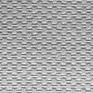
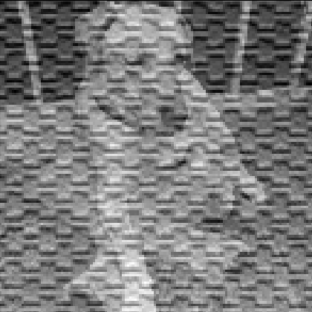

Dictionary Learning with two Dictionaries
$$\underset{D1,D2, x1, x2}{argmin}{{\left\|y_{1}−D_{1}x_{1}\right\|}_{F}^{2}+{\left\|y_{2}−D_{2}x_{2}\right\|}_{F}^{2}+{λ\left\|{D_{1}}^{T}D_{2}\right\|}_{F}^{2}+Γ_{x} \left(x_{1}\right)+Γ_{x} \left(x_{2}\right)+Γ_{D} \left(D_{1}\right)+Γ_{D} \left(D_{2}\right)}$$
$$y_{1}$$ | : | picture 1
$$y_{2}$$ | : | picture 2
$$D_{1}$$ | : | dictionary for picture 1
$$D_{2}$$ | : | dictionary for picture 2
$$x_{1}$$ | : | sparse representation of picture 1 for $D_{1}$
$$x_{2}$$ | : | sparse representation of picture 2 for $D_{2}$
$$λ$$ | : | regularization parameters
$$Γ_{x}$$ | : | constraint for x (make it sparse)
$$Γ_{D}$$ | : | constraint for D (normalize)

Slide 3
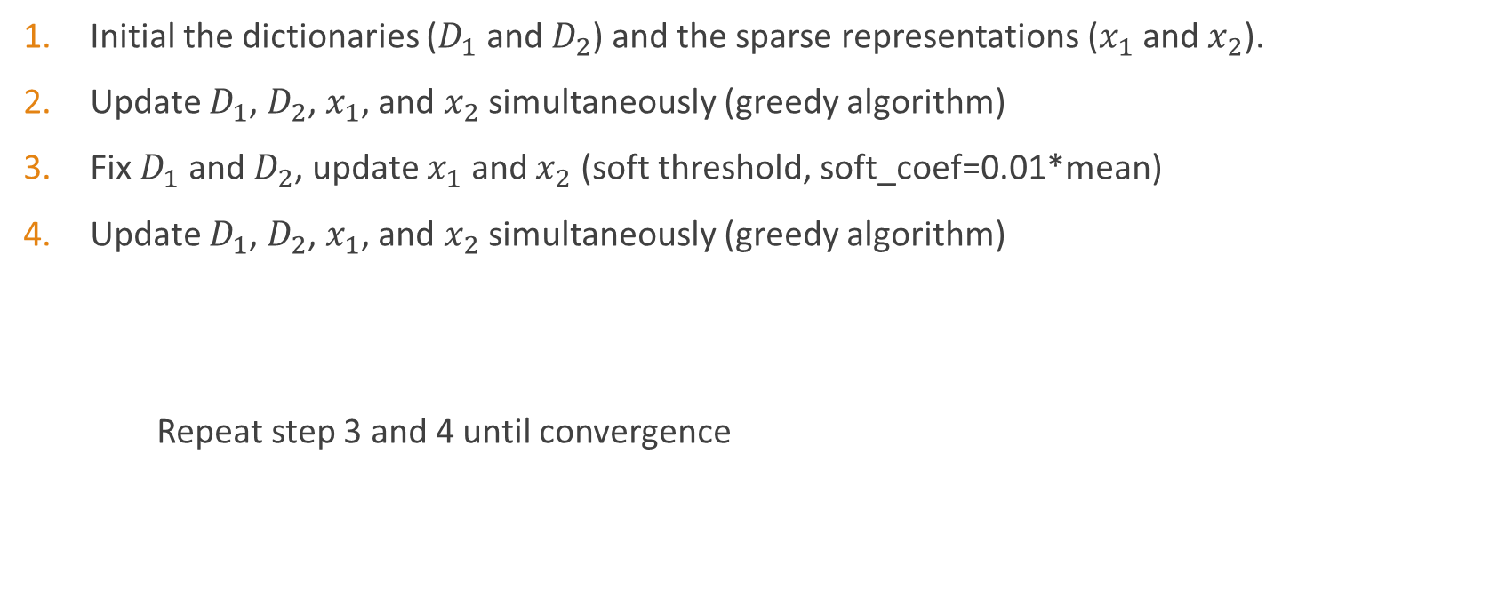
Dictionary Training Method
Initial the dictionaries ($D_{1}$ and $D_{2}$) and the sparse representations ($x_{1}$ and $x_{2}$).
Update $D_{1}$, $D_{2}$, $x_{1}$, and $x_{2}$ simultaneously (greedy algorithm)
Fix $D_{1}$ and $D_{2}$, update $x_{1}$ and $x_{2}$ (soft threshold, soft_coef=0.01*mean)
Update $D_{1}$, $D_{2}$, $x_{1}$, and $x_{2}$ simultaneously (greedy algorithm)
Repeat step 3 and 4 until convergence

Slide 4

Sparse Coding with two Dictionaries
$$\underset{x1, x2}{argmin}{{\frac{1}{2}\left\|y−D_{1}x_{1}−D_{2}x_{2}\right\|}_{F}^{2}+}{λ_{1}\left\|x_{1}\right\|}_{ 0}+{λ_{2}\left\|x_{2}\right\|}_{ 0}$$
Initial the sparse representation ($x_{1}$ and $x_{2}$).
Update $x_{1}$ and $x_{2}$ (soft thresholding, soft_coef=0.01*mean).
Update $x_{1}$ and $x_{2}$ (greedy).

Slide 5
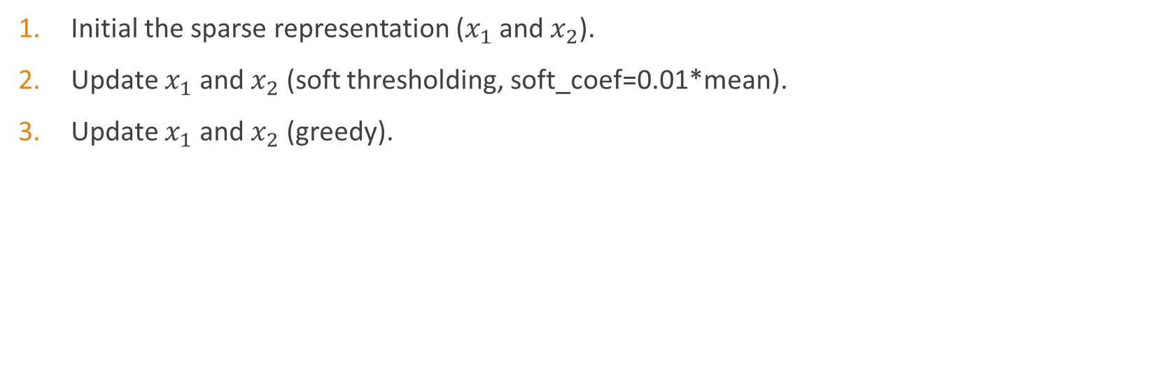
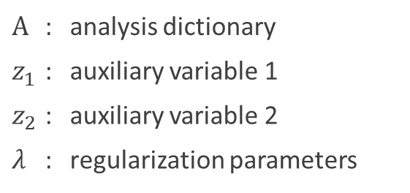
Sparse Coding with two Dictionaries and a Analysis Dictionary
$\underset{x1, x2}{argmin}{{\frac{1}{2}\left\|y−D_{1}x_{1}−D_{2}x_{2}\right\|}_{F}^{2}+{λ_{1}\left\|x_{1}\right\|}_{ 0}+{λ_{2}\left\|x_{2}\right\|}_{ 0}+}$ ${\frac{λ_{3}}{2}\left\|AD_{1}x_{1}−z_{1}\right\|}_{F}^{2}$+ ${\frac{λ_{4}}{2}\left\|AD_{2}x_{2}−z_{2}\right\|}_{F}^{2}+{λ_{5}\left\|z_{1}\right\|}_{ 0}+{λ_{6}\left\|z_{2}\right\|}_{ 0}$
Initial the sparse representation ($x_{1}$ and $x_{2}$).
Update $x_{1}$ and $x_{2}$ (soft thresholding, soft_coef=0.01*mean).
Update $x_{1}$ and $x_{2}$ (greedy).
$$A$$ | : | analysis dictionary
$$z_{1}$$ | : | auxiliary variable 1
$$z_{2}$$ | : | auxiliary variable 2
$$λ$$ | : | regularization parameters

Slide 6
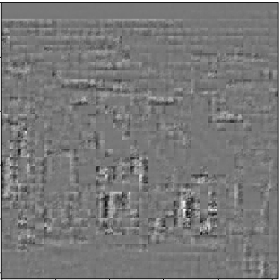
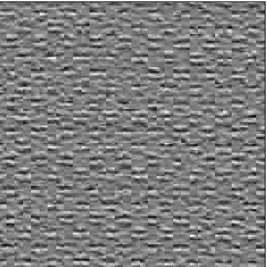
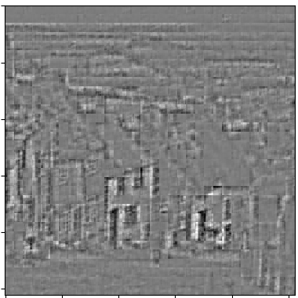
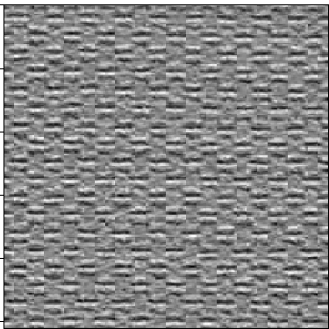

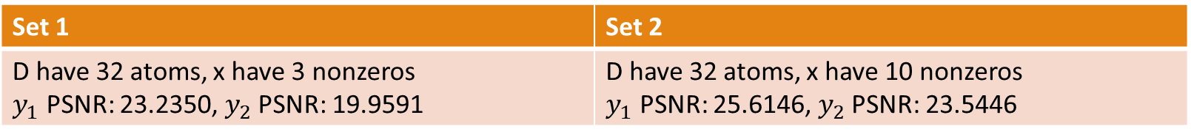




Experiment
To simplify the problem, let$y_{1}=D_{1}∗x_{1}$, $y_{2}=D_{2}∗x_{2}$
Two sets of y1 and y2 for experiment
Set 1 | Set 2
D have 32 atoms, x have 3 nonzeros $y_{1}$ PSNR: 23.2350, $y_{2}$ PSNR: 19.9591 | D have 32 atoms, x have 10 nonzeros $y_{1}$ PSNR: 25.6146, $y_{2}$ PSNR: 23.5446
Set 1 $y_{1}$
Set 1 $y_{2}$
Set 2 $y_{1}$
Set 2 $y_{2}$

Slide 7
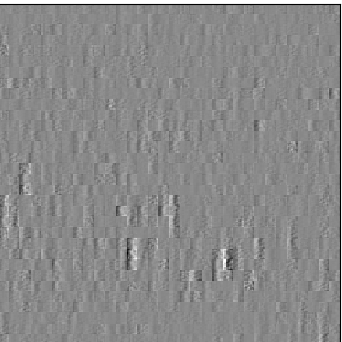
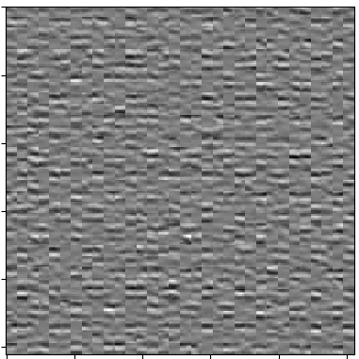


The Result of Sparse Coding for Image Set 1
Sparse Coding by two orthogonal dictionaries
Image 1 (sparse coding from y1+y2):
y1(DL) PSNR=27.7252
D1x1(after two orthogonal DL) PSNR=34.2670
Image 2 (sparse coding from y1+y2):
y2(DL) PSNR=24.5836
D2x2(after two orthogonal DL) PSNR=28.0402
$y_{1}$
$y_{2}$
Image 1
Image 2

Slide 8
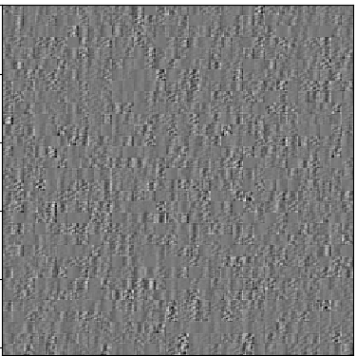
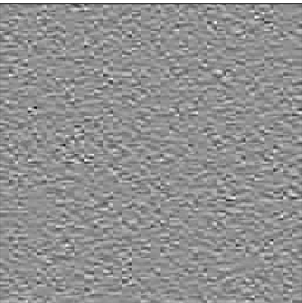


The Result of Sparse Coding for Image Set 1
Sparse Coding by two orthogonal dictionaries and a analysis dictionary
Image 1 (sparse coding from y1+y2):
y1(DL) PSNR=24.8747
D1x1(after two orthogonal DL) PSNR=27.5470
Image 2 (sparse coding from y1+y2):
y2(DL) PSNR=19.2220
D2x2(after two orthogonal DL) PSNR=21.3965
$y_{1}$
$y_{2}$
Image 1
Image 2

Slide 9
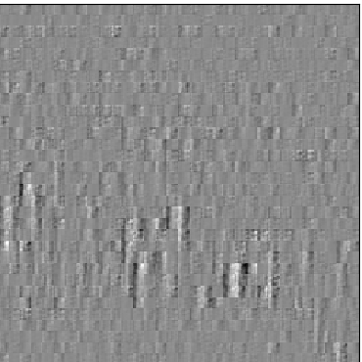
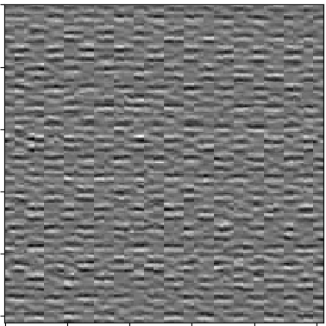


The Result of Sparse Coding for Image Set 2
Sparse Coding from two orthogonal dictionaries
Image 1 (sparse coding from y1+y2):
y1(DL) PSNR=25.5493
D1x1(after two orthogonal DL) PSNR=31.1082
Image 2 (sparse coding from y1+y2):
y2(DL) PSNR=22.2436
D2x2(after two orthogonal DL) PSNR=26.8120
$y_{1}$
$y_{2}$
Image 1
Image 2

Slide 10
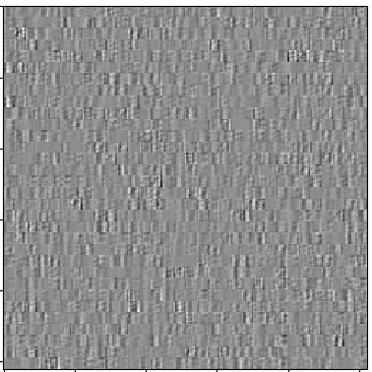
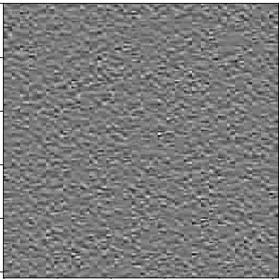


The Result of Sparse Coding for Image Set 2
Sparse Coding from two orthogonal dictionaries and a analysis dictionary
Image 1 (sparse coding from y1+y2):
y1(DL) PSNR=23.3555
D1x1(after two orthogonal DL) PSNR=26.7490
Image 2 (sparse coding from y1+y2):
y2(DL) PSNR=17.5180
D2x2(after two orthogonal DL) PSNR=20.1070
$y_{1}$
$y_{2}$
Image 1
Image 2

